Slide 1



Dynamic Care Team Management
Presented by Emma Jones, Tedford Johnson

Slide 2
The Problem
Identifying and coordinating care amongst providers and caregivers can be difficult for patients suffering from complex and/or chronic health conditions
Care teams have many different meanings to many different people
We need a useful way to facilitate the management of applicable care providers and caregivers to support evolving and ongoing care coordination

Slide 3
The Solution
Coordination Framework:
HL7 DAM as the model framework
HL7 Care Coordination Service Functions
HL7 FHIR Resource and IHE Profiles to support CCS Capabilities
Care Team Membership
Care Team Communication

Slide 4
The Vision
Develop a Care Team Management profile that will:
Provide a method to consolidate the many care team members that can be associated with a patient
Provide a framework for managing care team members
Meet the needs of many stakeholders

Slide 5
Use Case
Care Plan Driven Care teams
Transitions in care
Example: Discharge from Acute Care to Post Acute Care
a) Provider to Provider, Team to Team, Provider to Team, …. transition
b) Support multi-disciplinary care coordination between providers and patient/caregivers
Chronic Disease Management
a) Management and treatment of chronic health issues
b) Coordination of referring providers and consulting providers
Notes:
Care Team – roles need to be international (part of defining what a care team is)
Discussion point: Process or model around discharge planning, care coordination
Care team member related to the problem

Slide 6
Use Case
Non-Care Plan Driven Care teams
Supportive-Care Care Teams supports implications for
Quality of care
Quality of life
Healthcare financing
Indirectly relates to the health care system
Researchers
Notes:
Not all care teams and directly tied to the health care system
Teams that exist and contributes to the well being of the patient that the healthcare system teams need to interact with or at minimal be aware of.
Researchers may not contribute to the care plan but need to to be aware

Slide 7
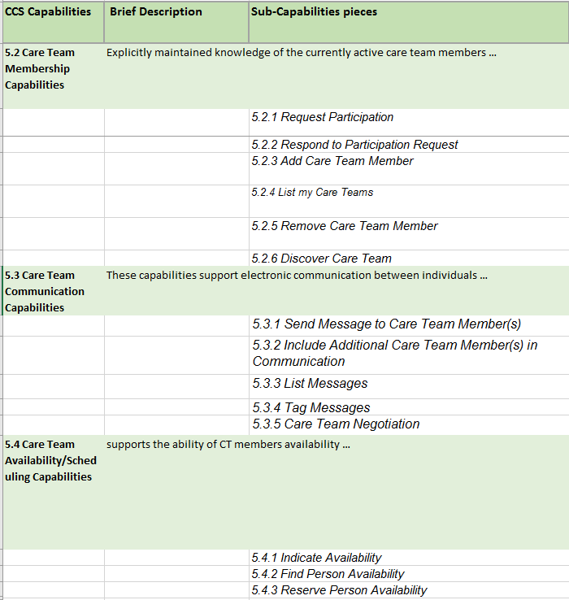
CCS Capabilities

Slide 8
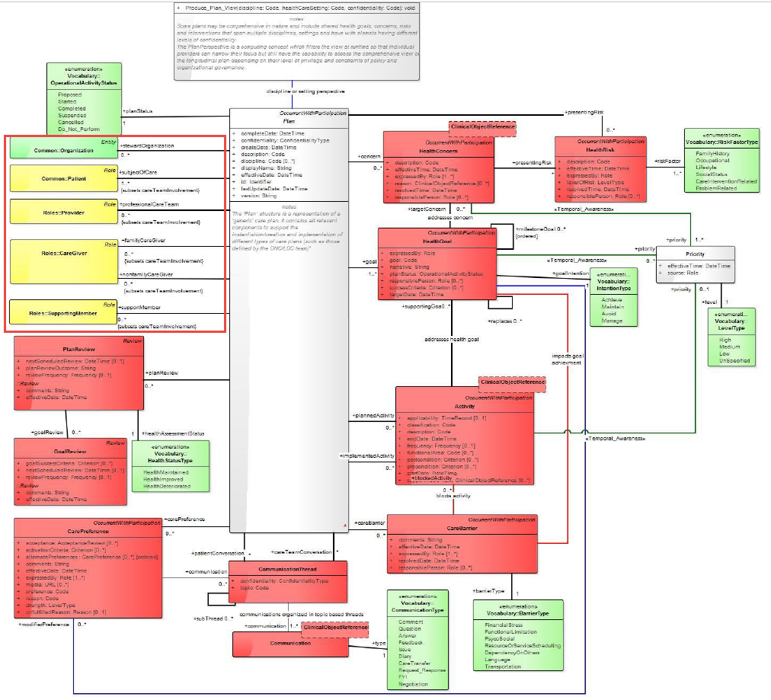
Source: HL7 Domain Analysis Model

Slide 9
Standards
HL7 CCS Functional Model
FHIR
IHE PIX and ATNA
?? HPD
??? Existing group membership standards

Slide 10
Actors
New
Care Team Contributor
Care Team Service
Possibly others depending on standards discovery
Existing
Content Creator
New Transactions
Content Consumer
New Transactions
Reconciling Agent

Slide 11
Impact on Existing Profiles
It could inform the structures of future profiles
It could be leveraged relative to any other profile that includes care teams or care team members.

Slide 12
Tasks to be Completed
Orientation: The IHE team should receive a presentation of the HL7 CP DAM and the CCS concepts for care team management.
Gather existing profiles: The IHE project team should gather its existing profiles that pertain to Care Team Management
FHIR Resources: Examine and harmonize existing FHIR resources that can be used to support the applicable CCS capabilities

Slide 13
Risks
Scope Creep
Technical Risk
Some FHIR resources are still in flux (on going modifications)
Identifying and re-using appropriate technology
Redundancy - many groups are working on FHIR care team profiling

Slide 14
Conclusion
This effort will provide a mechanism to facilitate programmatic care team management for the same patient between applicable care providers and the patient/caregiver to support dynamic, evolving and ongoing care coordination.

Slide 15
Thank You

